Slide 1
The Perfect Prompt
Getting Students to Write What You Want to Read
The Writing Program | Dr. Courtney L. Werner | Faculty Development in Writing Pedagogy Workshop Series
October, 2014

Slide 2
Not what you thought you asked for?
Sometimes, students don’t write what we expect.
Other times, students don’t write what we assign.

Slide 3
Why I write?
Take 2 minutes to write down some quick notes about why you write.
Well, why do you write?

Slide 4
Purposes for Assigning Writing
First, know why you want to assign writing!
Developing content knowledge (writing to learn)
Demonstrating content knowledge
Using disciplinary methods or foundations
Acquiring critical thinking skills or experiment with complexity and critical thinking
Applying course knowledge to new areas of inquiry

Slide 5
Related purposes
Will you be creating, breaking, or reinforcing genre/disciplinary conventions (Glenn & Goldthwaite, 2014)?
What are the objectives of the course, and how will the paper help meet those objectives?
Have you talked with your students about objectives?
What about audience and disciplinary awareness?

Slide 6
Leave room for students’ voices
Bishop and Ostrom (1997) suggest we “return [the power of discourses and genres] to our students, encouraging alternate understanding of genre as form and as social practice” (p. 1).
Leave room for student topics and interests
Be mindful of student knowledge and background
Avoid too-personal questions

Slide 7
Encourage interested inquiry
Meaningful within students’ experiences (classroom or other)
Specific/immediate situations
When possible, encourage personalized approaches

Slide 8
Assign writing with your purpose in mind
The Writer’s Reference (Hacker & Sommers, 2014) recommends students pick apart writing prompts using three key features:
Key Terms
Purpose
Evidence

Slide 9
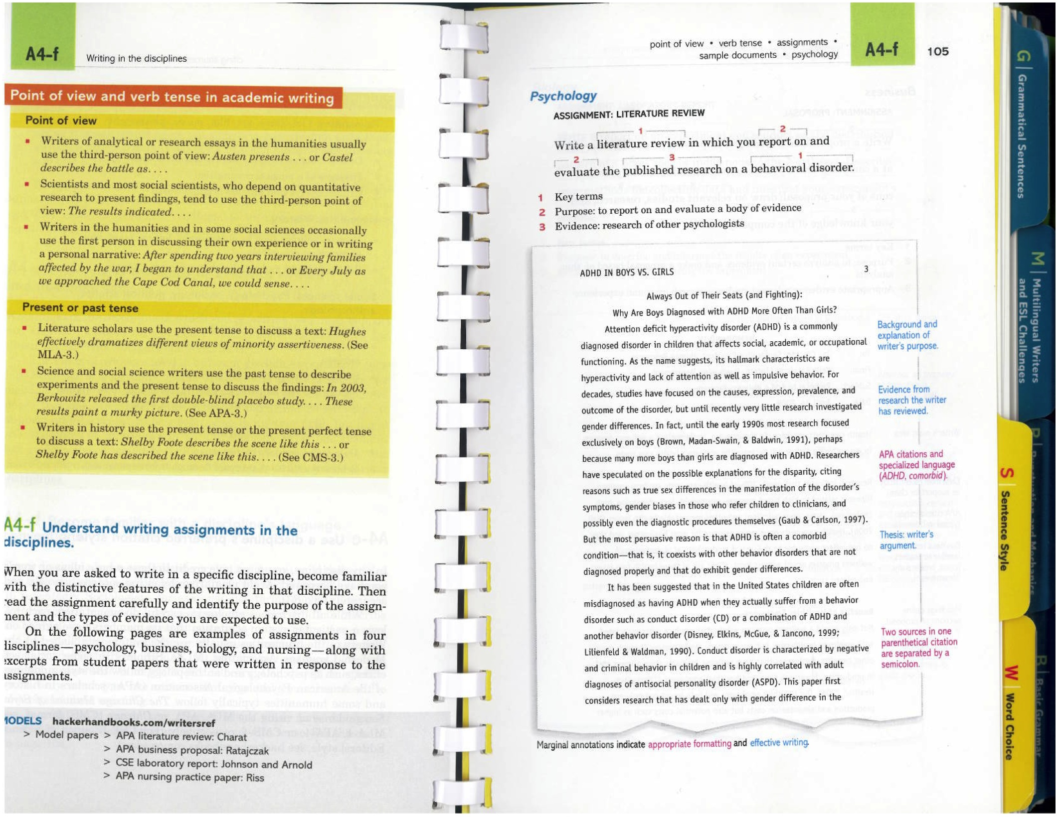

Slide 10
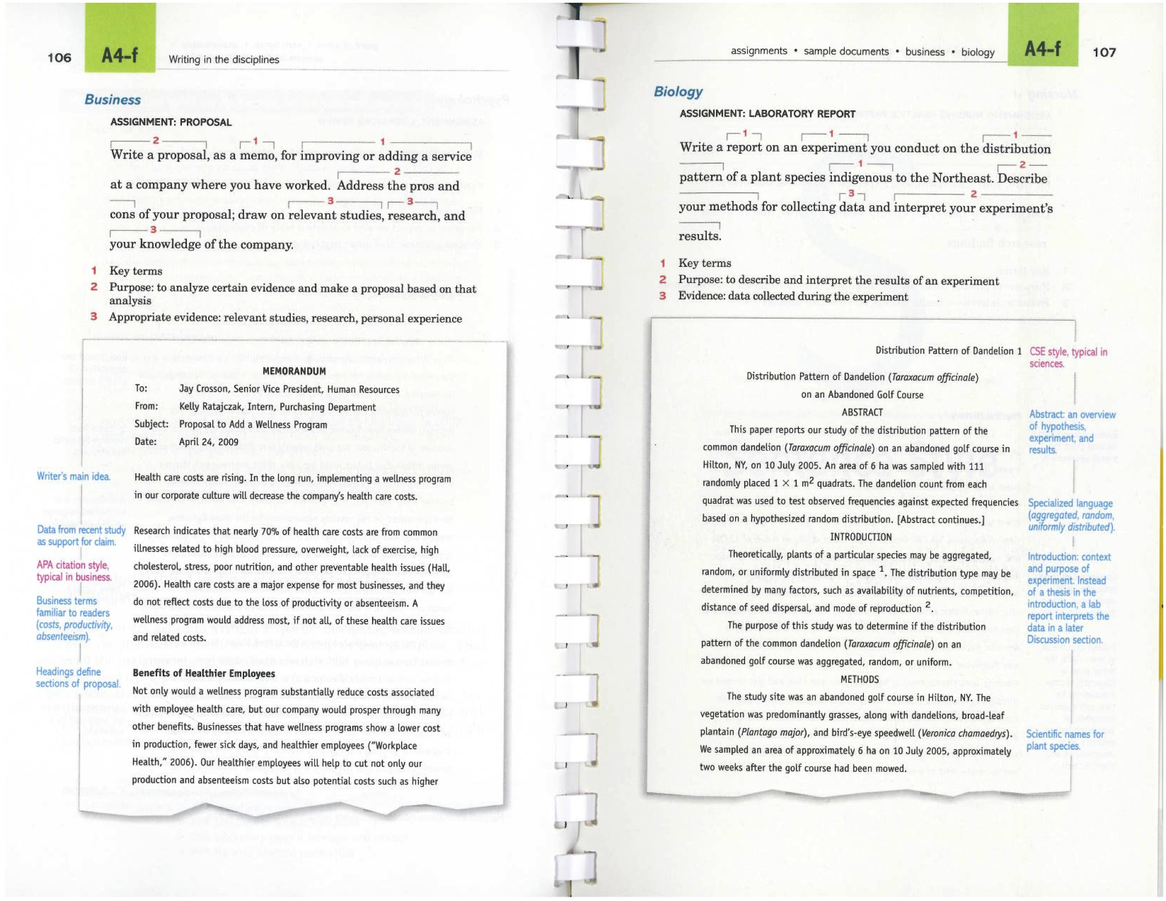

Slide 11
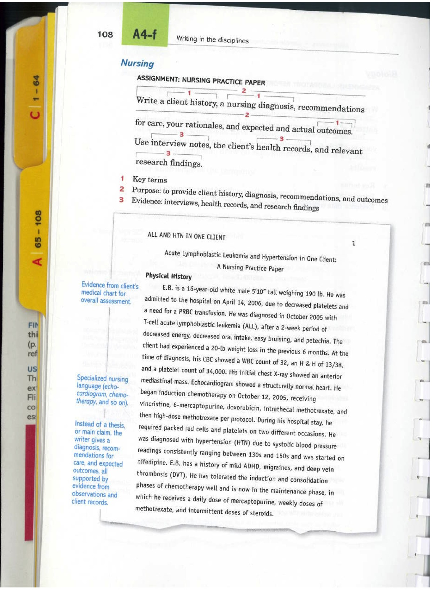

Slide 12
Keep it simple, silly!
The more details, the more daunting.
Leave your rubric/evaluation guidelines for a separate handout
Include necessary details such as:
page/word count
formatting style
required evidence (where applicable)

Slide 13
Prompt mechanics
Avoid assignments that ask a true/false, yes/no question
Avoid asking more than one question
Avoid very short prompts (may fail to guide students sufficiently)
Avoid long prompts (too confusing)
When possible, sequence and/or scaffold an assignment
Work on parts of the assignment in class, as a class
Encourage discussion during office hours
Encourage feedback at the KC
Give the KC a copy of your prompt

Slide 14
Are these prompts (in)effective?

Slide 15
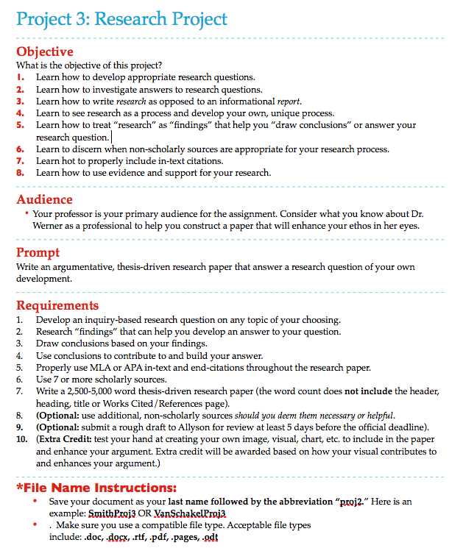

Slide 16
Project 2: Analysis
Assignment:
Argumentative synthesis with illustrations of all readings (Schell, Rawson, and Hesford). 600-1200 words, APA style.

Slide 17
References
Bishop, W. & Ostrom, H. (1997). Genre and writing: Issues, arguments, alternatives.
Portsmouth: Boynton/Cook.
Bowell, H. (Mar. 17, 2014). Up animated gif. http://hannahbowell14.tumblr.com/
post/45579038989
CommunityThings. (Aug. 22, 2014). Community animated gif. http://
communitythings.tumblr.com/post/29978566045
Glenn, C. & Goldthwaite, M. A. (2014). The St. Martin’s guide to teaching writing,
7th ed. Boston: Bedford/St. Martin’s.
Emmastone-Rphelp. (nd). Ryan Gosling animated gif. http://emmastone-
rphelp.tumblr.com/post/29180463702/ryan-gosling-gif-hunt
Moses & Guy. (Dec 12, 2012). Sherlock animated gif. http://
hungry4horan.tumblr.com/post/37733851208/page-6-10-and-ive-run-out-of-
things-to-talk-about

