Slide 1
Student Peer Review
Presented by the CWR & College Writing Program
Courtney L. Werner, Spring 2014

Slide 2
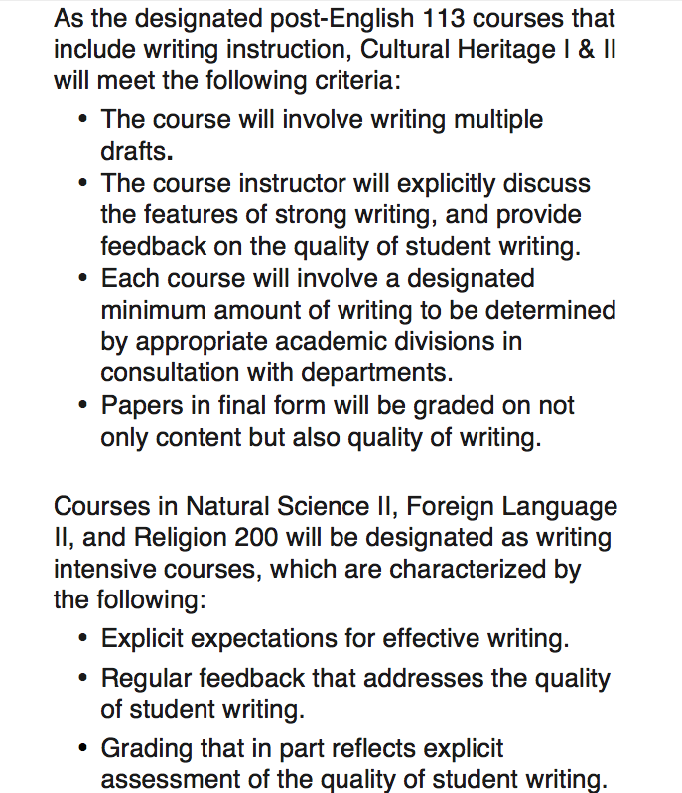
Why peer review?
Practicality
College Writing Instruction Policy
Students need a real audience
Students need feedback
Some courses need to fulfill the college writing policy requirements

Slide 3
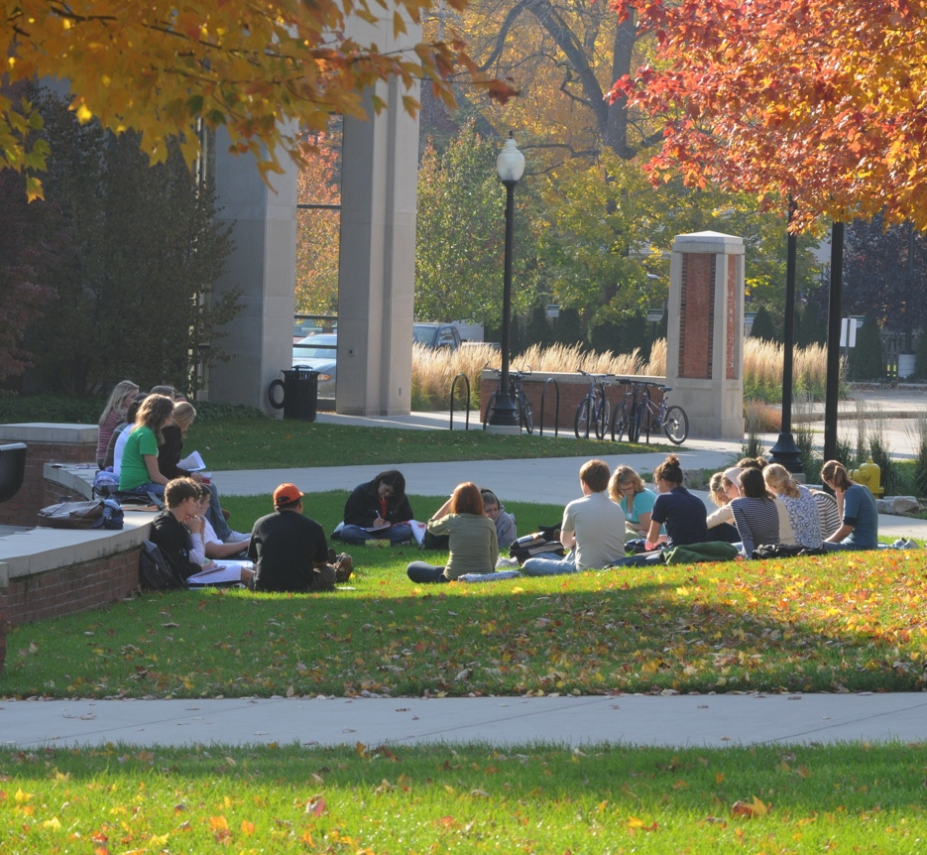
Why peer review?
Foundational Pedagogies: 1970s-1990s
Talking about writing can facilitate stronger revisions!
Process and drafting
Peer writing centers
Conversation about writing
Post-process social constructivism

Slide 4
Make better peer reviews:
Set a foundation
Explain peer review
Model peer review as a class
Model as a class and/or with an advanced student you know well
Have students set parameters (and create a rubric)
Talk about your peer review process!
Invite a few CWR assistants
Use a writing center model for global concerns
  Require written feedback (not on the paper)
  Ask “what do you want to work on?”

Slide 5
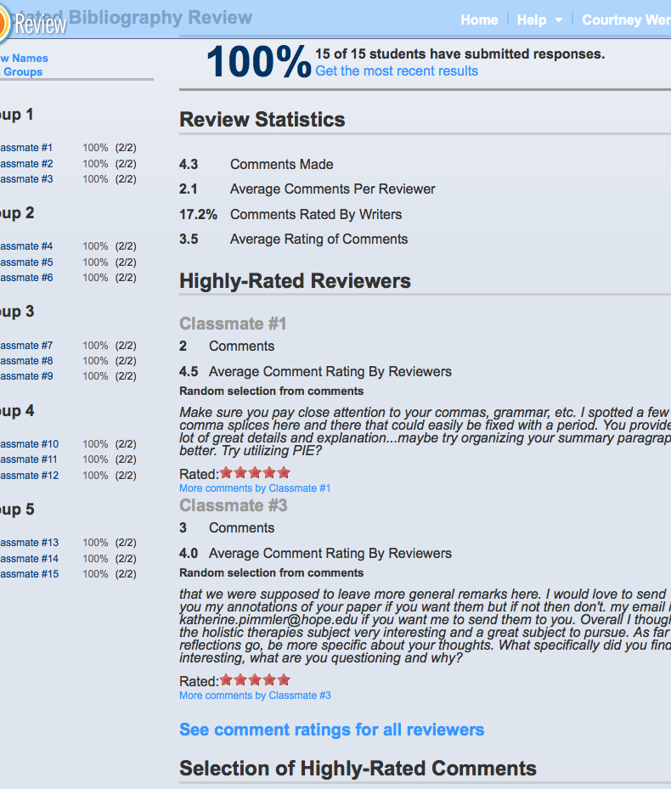
Make it more social
Writing groups
Workshop model
Moodle and Twitter
Use comment features (or color-coordinate)
EliReview.com (and encourage using the rating system)
  Institutional code:
  thieve896months

