Slide 1
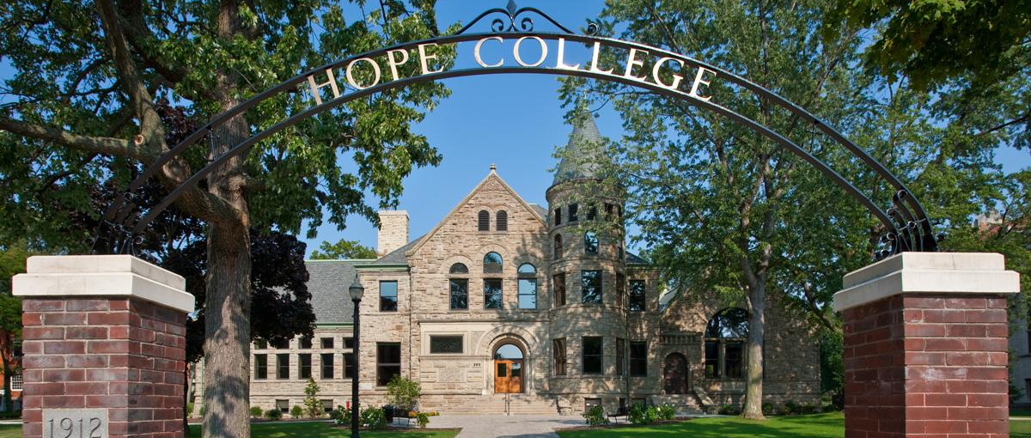
The State of Hope College Assessment

Slide 2
Hope College Assessment Plan
Created by Assessment Committee
Foster a student learning culture
Supports student achievement
Provides a process for sharing evidence of student learning
Helps identify and respond to data as a part of a continuous improvement process
Demonstrates we meet our institutional mission
See the entire plan at: https://hope.edu/offices/frost-research-center/assessment/

Slide 3
Assfdsa
Research “The use of data for the purpose of describing, predicting, and controlling as a means toward better understanding the phenomena under consideration…” Huitt, Mummiel & Kaeck (2001) | Evaluation “Comparison of data to a standard for the purpose of judging worth or quality” Huitt, Mummiel & Kaeck (2001) “Using data to make judgments regarding programs or services.” (Student Affairs Assessment) | Assessment of Student Learning Purpose of improving learning experiences Collect better data about what and how students learn Identify learning gaps and address them Leads to action
Huitt, W., Hummel, J., & Kaeck, D. (2001). Assessment, measurement, evaluation, and research. Educational Psychology Interactive. Valdosta, GA: Valdosta State University. Retrieved [date], from http://www.edpsycinteractive.org/topics/intro/science.html
Henning, Gavin & Roberts, Darby. (2016). Student Affairs Assessment. Routledge.
Notes:
“Assessment refers to the collection of data to describe or better understand an issue…research refers to the use of data for the purpose of describing, predicting, and controlling as a means toward better understanding the phenomena under consideration, and evaluation refers to the comparison of data to a standard for the purpose of judging worth or quality” (para. 2).
Huitt, Hummiel, & Kaeck (2001)

Slide 4
Evaluation Identifies usage and participant numbers quality of activities provided satisfaction credentialing and staff training resources allocated to the program | Assessment of Student Learning Identifies Knowledge, skills, & behaviors that students demonstrate after participating in or completing the program or activity Are students meeting the set learning standards?

Slide 5
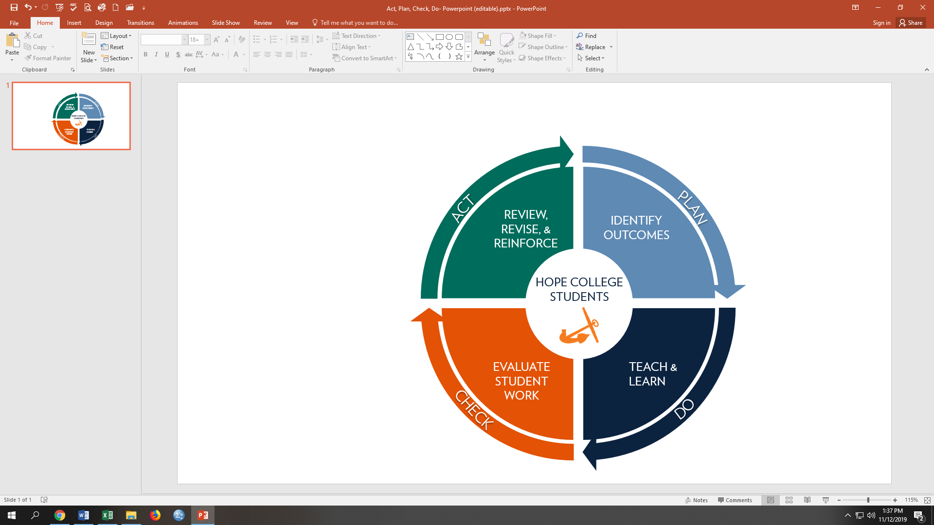
Assessment Cycle
Assessment: An ongoing, systematic process that begins with developing student learning outcomes, followed by the collection, review, and use of information about those outcomes for the purpose of improving student learning.

Slide 6
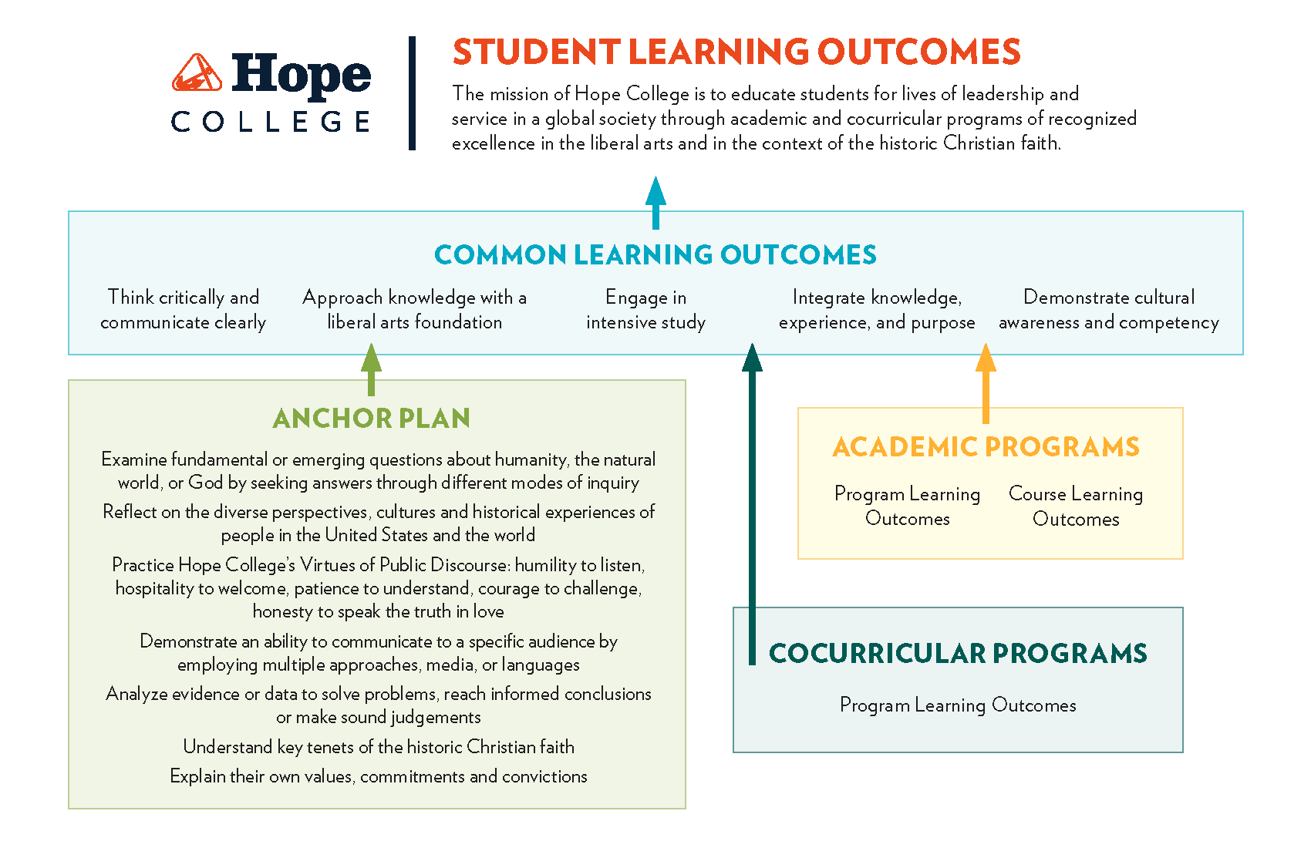

Slide 7
Direct Assessment Using measures that require students to actually display or demonstrate the extent of their learning Embedded assessments Major field tests Applying rubrics to artifacts | Indirect Assessment Collecting student reflections or self-assessments about student learning without actually demonstrating their knowledge, skills, or behaviors Graduate surveys Senior surveys NSSE

Slide 8

 | Common Learning Outcomes
 | 1. Think Critically and Communicate Clearly | 2. Approach knowledge with a liberal arts foundation | 3. Engage in intensive study | 4. Integrate knowledge, experience and purpose | 5. Demonstrate cultural awareness and competency
Assessment Tool
Heighten Critical Thinking Assessment | X
Heighten Intercultural Competency and Diversity Assessment |  |  |  |  | X
NSSE | X | X | X | X | X
Intellectual Engagement with the Christian Faith Survey |  | X
Artifacts |  | X
6- Months Out Graduate Survey |  |  | X
National Alumni Career Mobility Survey |  |  | X
Lifeview Paper |  |  |  | X
Review Schedule
Summer of Odd Years | X | X
Summer of Even Years |  |  | X | X | X

Slide 9

Common Learning Outcome 3
Engage in Intensive Study
Six Months Out Graduate Survey 2019-2023
95% of Hope graduates felt they were prepared for graduate school and employment
NACM Survey 2021-2023
A higher percentage of alumni feel their bachelor’s degree prepared them for their career than the comparison group
Hope graduates compare favorably to the comparison group overall

Slide 10
Common Learning Outcome 4
Integrate Knowledge, Experience and Purpose
NSSE: Reflective and Integrative Learning
Hope senior scores slightly decreased in 2024, but we remain higher than our comparison group of Great Lakes Private institutions.
Lifeview Paper
60 papers sampled
Some formats of papers lent themselves to better scores
  Impacted by writing prompt

Slide 11
Common Learning Outcome 5
Demonstrate Cultural Awareness and Competency
Heighten ICDA
95% of seniors scored proficient or advanced for Analyze and Act
Students who study abroad had higher Approach scores
NSSE
The target for the diverse others engagement indicator was met
Three items where Hope College students scored lower than the GLP institutions may be related to the makeup of Hope’s student body

Slide 12
Looking Forward
Celebrate!
Is the data we’re gathering meaningful?
Are our current assessment plans meaningful and actionable?
Use assessment to make decisions and then tell a story.
Notes:
- What data are you gathering? And how do you use it? More than just a curiosity?
- Are your teams equipped to use the data? Training needed?
Now that one review cycle is complete, we need to be asking how to improve the process. Find a line between ‘just more work’ and making it happen.
What are our goals and how do we know we’re hitting them?
How can assessment play a role in meeting the strategic plan?
I’m still learning and observing and wanting to match the strategic plan

Slide 13
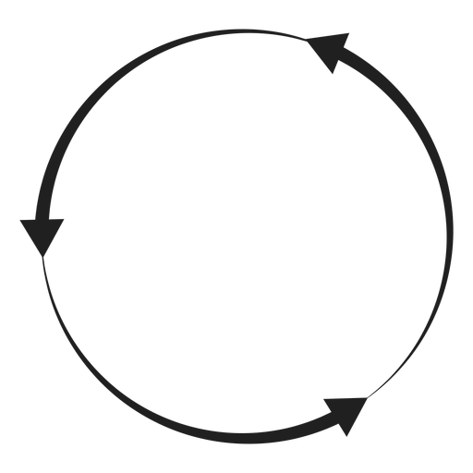
Assessment Cycle
Assessment: An ongoing, systematic process that begins with developing student learning outcomes, followed by the collection, review, and use of information about those outcomes for the purpose of improving student learning.

Slide 14
Common Learning Outcome Tools
Direct
Heighten Critical Thinking Assessment
Artifacts (APLO 1 Analysis)
Senior Seminar Lifeview Paper
Heighten Intercultural Competency and Diversity Assessment
Indirect
National Survey of Student Engagement
Intellectual Engagement with the Christian Faith Survey
Six Months Out Graduate Survey
National Alumni Career Mobility Survey
Notes:
R4.

Slide 15
Intercultural Competency and Diversity
 | First Year Students | Senior Students
AY 2023-2024 | 582 | 119
AY 2024-2025 | 586 | 250
Total | 1,168 | 369
Critical Thinking Senior Students
AY 2023-2024 | 41
Fall 2024 | 19
Winter 2024 | 106
Total | 166
Notes:
Discussion – how to improve this?
Pull numbers – which of the students from this semester came from programs pushing it?

Slide 16
Coming Up in Assessment
Increase Assessment Response Rates
Survey Schedule and Survey Strategy
Anchor Plan Learning Outcome Assessment
Artifact Analysis May 19-20
Common Learning Outcome Assessment
Engage Assessment Teams for data analysis – Outcomes 1 & 2
CLO Reports to AcAB – April 15
Program Learning Outcome Assessment
Reports due October 1, 2025

Slide 17
 | Anchor Plan Outcomes
 | 1. Examine fundamental and emerging questions... | 2. Reflect on diverse perspectives... | 3. Practice Hope College's Virtues of Public Discourse | 4. Demonstrate ability to communicate... | 5. Analyze evidence or data... | 6. Understand Key tenets... | 7. Explain one's own values...
Assessment Tools
Heighten Critical Thinking Assessment |  |  |  |  | X
Heighten Intercultural Competency and Diversity Assessment |  | X | X
Artifacts | X |  |  | X |  | X
Lifeview Paper |  |  |  |  |  |  | X
Review Schedule
Summer of Odd Years | X |  |  | X | X
Summer of Even Years |  | X | X |  |  | X | X

