Slide 1
Hope Student Retention & Persistence
Frost Center Friday
November 18, 2022
Donald Friesner, Director of Institutional Research
Eric Jones, Ph.D., Data and Research Coordinator
hope.edu/frostcenter
hope.edu/data

Slide 2
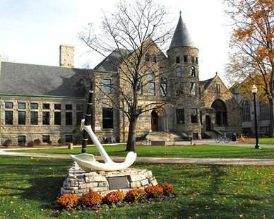
Overview
Analysis includes students who met the following criteria:
  Cohort Term: F2016, F2017, F2018, F2019, F2020, or F2021
  Cohort Type: First time in any college (FTC) or FOCUS
  Sample size = 4275
Demographic variables from Banner
  Race
  Gender
  First-generation status
  Pell grant status at cohort term
  State (permanent residence)

Slide 3
Overview
Data about which activities students were involved in from Banner
ASU
BSU
CASA
Dance Marathon
Greek Life
Hope Catholics
HIYA
LSO
Music
Nykerk
Orientation
PASA
Phelps Scholars
Prism
The Pull
Spring Break Immersion Trip
SOAR
Athletics
Student Congress
Bridge
WEO
HAIC

Slide 4
Overview
Retention and persistence
Cohort | Class | 1-Year Retention | 2-Year Retention | 3-Year Retention | 4-Year Retention
201608 | Class of 2020 | X | X | X | X
201708 | Class of 2021 | X | X | X | X
201808 | Class of 2022 | X | X | X | X
201908 | Class of 2023 | X | X | X
202008 | Class of 2024 | X | X
202108 | Class of 2025 | X
X = included in analysis

Slide 5
Retention
By Demographics

Slide 6
What is Retention? How is it Measured?
  Cohort: “The group of students entering in the fall term established for tracking purposes. For the Graduation Rates component, this includes all students who enter an institution as full-time, first-time degree or certificate-seeking undergraduate students during the fall term of a given year.”
    National Center for Education Statistics
  Retention Rate: “A measure of the rate at which students persist in their educational program at an institution, expressed as a percentage. For four-year institutions, this is the percentage of first-time bachelors (or equivalent) degree-seeking undergraduates from the previous fall who are again enrolled in the current fall.”
  National Center for Education Statistics
  Retention Calculation: Cohort grads + Returning Cohort/(Cohort - Exclusions)
      (Death, Permanent Disability, Military Deployment, Official Church Mission)

Slide 7
Retention by Gender

Slide 8
Retention by Race

Slide 9
Retention by Gender and Race
Female
Male

Slide 10
Retention by First-Gen and Pell Status

Slide 11
Retention by Race, First-Gen, and Pell Status
Students of Color
White

Slide 12
Retention by Race and State (Permanent Residence)
Students of Color
White

Slide 13
Retention by First-Gen and Pell Status
From Michigan
From Midwest (IL, IN, OH, WI)
From Other State

Slide 14
Regression Analysis
SUMMARY OUTPUT
Regression Statistics
Multiple R | 0.169018011
R Square | 0.028567088
Adjusted R Square | 0.027638376
Standard Error | 0.355492335
Observations | 4189
ANOVA
 | df | SS | MS | F | Significance F
Regression | 4 | 15.54910217 | 3.887276 | 30.75989 | 2.82644E-25
Residual | 4184 | 528.752163 | 0.126375
Total | 4188 | 544.3012652
 | Coefficients | Standard Error | t Stat | P-value | Lower 95% | Upper 95%
Intercept | 1.016207983 | 0.02150073 | 47.26388 | 0 | 0.974055134 | 1.058360833
Race | 0.032751112 | 0.011799032 | 2.775746 | 0.005532 | 0.009618743 | 0.055883482
Gender | 0.053350584 | 0.011326507 | 4.710242 | 2.55E-06 | 0.031144615 | 0.075556553
PELL | 0.031859374 | 0.015040795 | 2.118198 | 0.034217 | 0.002371428 | 0.061347321
First-Gen | 0.122845114 | 0.016669713 | 7.36936 | 2.05E-13 | 0.090163623 | 0.155526605

Slide 15
National Student Clearinghouse Summary
Description | 5 Year Average
Four-year degree from your institution | 599.8
Two-year degree from your institution | 0
Certificate from your institution | 0
Four-year degree from other institution | 69
Two-year degree from other institution | 16.2
Certificate from other institution | 9.2
Retained at your institution | 2702.8
Retained at other four-year institution | 272.4
Retained at other two-year institution | 147.2

Slide 16
What Happens to Non-Retained Students?
Top Ten Transfer-Out Colleges
Of those not retained over the past 10 years, 724 went on to get undergraduate degrees (Certificate, Associate, or Baccalaureate).
College | N
GRAND VALLEY STATE UNIVERSITY | 85
MICHIGAN STATE UNIVERSITY | 40
UNIVERSITY OF MICHIGAN | 28
WESTERN MICHIGAN UNIVERSITY | 26
FERRIS STATE UNIVERSITY | 20
CENTRAL MICHIGAN UNIVERSITY | 14
GRAND RAPIDS COMMUNITY COLLEGE | 14
WASHTENAW COMMUNITY COLLEGE | 12
DAVENPORT UNIVERSITY | 11
OAKLAND UNIVERSITY | 11
UNIVERSITY OF ILLINOIS @ URBANA | 11
Total | 187
Source: National Student Clearinghouse

Slide 17
Retention
By Student Activities

Slide 18
Retention by Race and Participation in CDI Student Organizations
**Fewer than 20 students in some cells, so results may not be reliable
Student Organizations: ASU, BSU, LSO, PASA, Prism, HAIC

Slide 19
Retention by First-Gen/Pell Status and Participation in CDI Student Organizations
No Involvement
Involvement in at Least 1
**Fewer than 15 students in some cells, so results may not be reliable
Student Organizations: ASU, BSU, LSO, PASA, Prism, HAIC

Slide 20
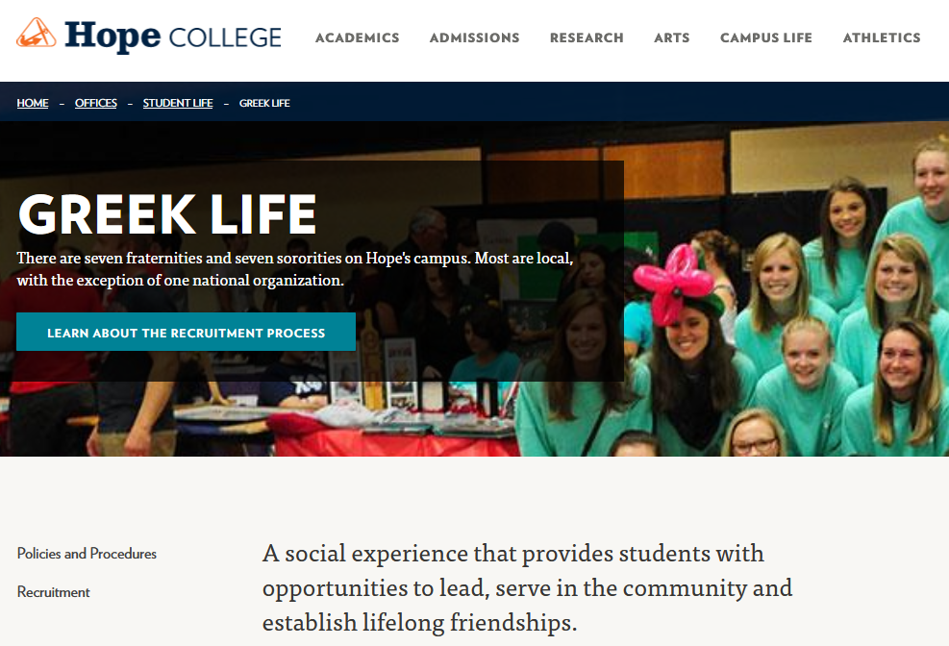

Slide 21
Retention by Race and Participation in Greek Life
**Fewer than 5 students per cell, so results may not be reliable

Slide 22
Retention by First-Gen/Pell Status and Participation in Greek Life
Not in Greek Life
Involved in Greek Life

Slide 23


Slide 24
Retention by Race and Participation in Athletics
**Fewer than 15 students per cell, so results may not be reliable

Slide 25
Retention by Race, Gender, and Participation in Athletics
Female
Male

Slide 26
Retention
By Activity Count

Slide 27
Retention and Number of Activities
Activity Count | 1-Year | 2-Year | 3-Year | 4-Year
0 | 88.0% | 84.2% | 85.2% | 84.6%
1 | 87.3% | 81.0% | 79.2% | 77.0%
2 | 94.6% | 89.2% | 86.7% | 86.2%
3 | 96.4% | 92.1% | 89.3% | 87.0%
4 | 97.8% | 95.5% | 93.5% | 92.9%
5 | 98.8% | 98.8% | 97.3% | 93.8%
6 | 100.0% | 96.8% | 96.4% | 90.0%
7 | 100.0% | 100.0% | 80.0% | 100.0%
8 | 100.0% | 100.0% | 100.0% | 0.0%
9 | 100.0% | 100.0% | 100.0% | 100.0%
Only 1-5 students per cell in these rows

Slide 28
Key observations
In general, retention rates were lower for:
  Male students
  Students of Color
  First generation students with Pell grants
Students involved in campus activities tended to have higher retention rates, but there were some exceptions for The Pull, athletics, and student congress.
  With a sweet spot in the range of 4-6 activities
First-Gen and Pell students who were not involved in student activities, did worse than others.
The majority of students not retained are continuing their education elsewhere. While these students are a loss to Hope, their education here, is not.

Slide 29
Discussion, conversation, questions
Who at Hope College (positions or departments) would benefit from the information shared today?
Thinking about your own work at Hope, how might you use what you’ve learned today?
How might data from this survey continuously inform decisions to benefit Hope students?

