Slide 1

Character Forward: Midway through the Grant
Frost Center Colloquium
February 26, 2026
Chad Carlson: Director of the Hope Character Hub
(and guest appearances from Chris Turlington and Ellen Awad)

Slide 2
ICYMI: What is this grant?
Hope received a 3-year, $700,000 Institutional Impact Award from Wake Forest’s Educating Character Initiative, funded by a Lilly Foundation grant
We are one of 24 projects (at 29 institutions) that received an award ($15.6M disbursed) in 2024
The project runs from Fall 2024 – Summer 2027

Slide 3
What is this grant?
The focus of the grant is character and virtue development, with a specific focus on generosity and gratitude
Hope has a history of prioritizing character development
  Virtues of Public Discourse frame our intellectual communal life
  Christian Aspirations frame our Christian communal life
  Hope Forward is a particular, focused expression of meaningful character development around generosity and gratitude

Slide 4
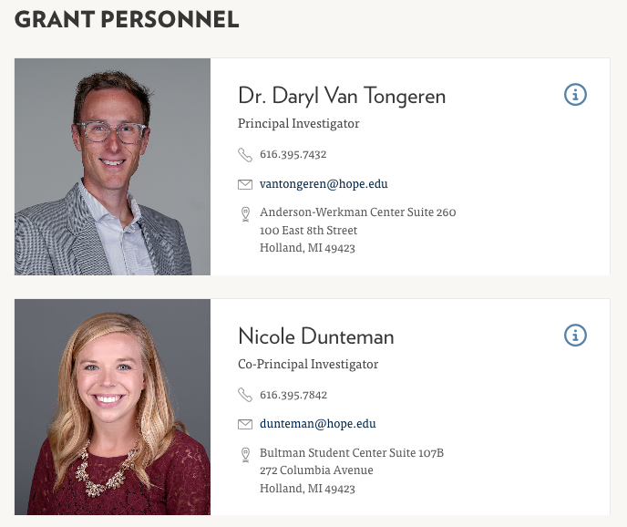
Who is involved?

Slide 5
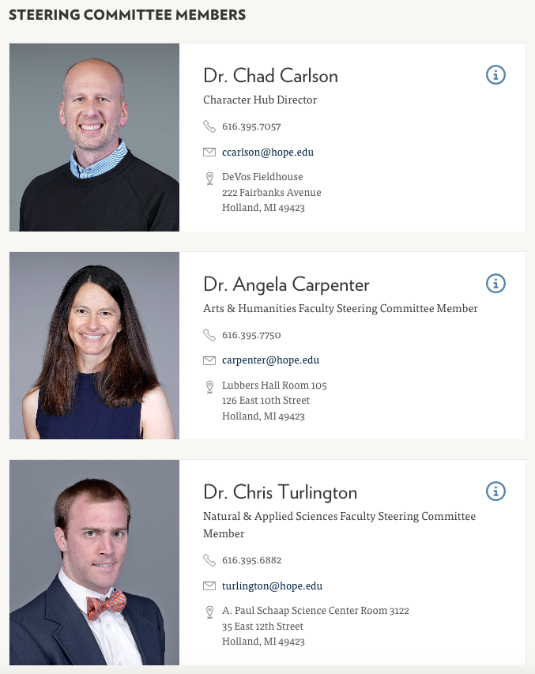
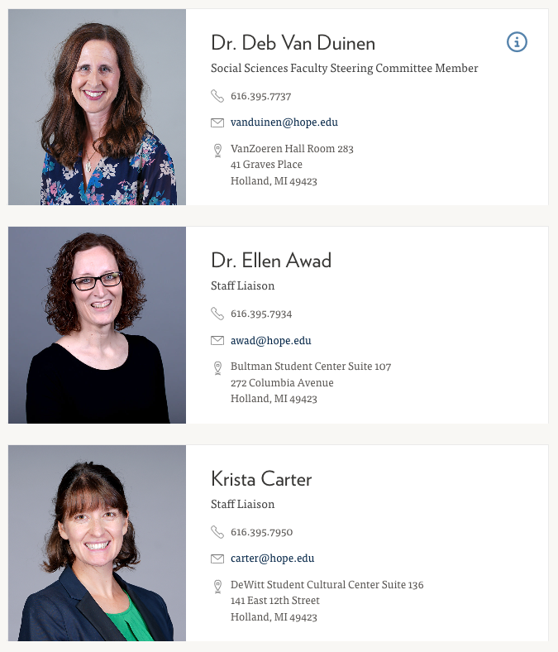
Who is involved?

Slide 6
What have we been up to?
Establishing a Character Hub
Research grants
Teaching fellowship
Workshops
Reflections Journal
Website
Assessment
Character Ambassadors

Slide 7
What’s our foundation?
Habituation through practice
Reflection on personal experience
Engagement with virtuous exemplars
Dialogue that increases virtue literacy
Awareness of situational variables and biases
Moral reminders
Friendships of mutual accountability

Slide 8
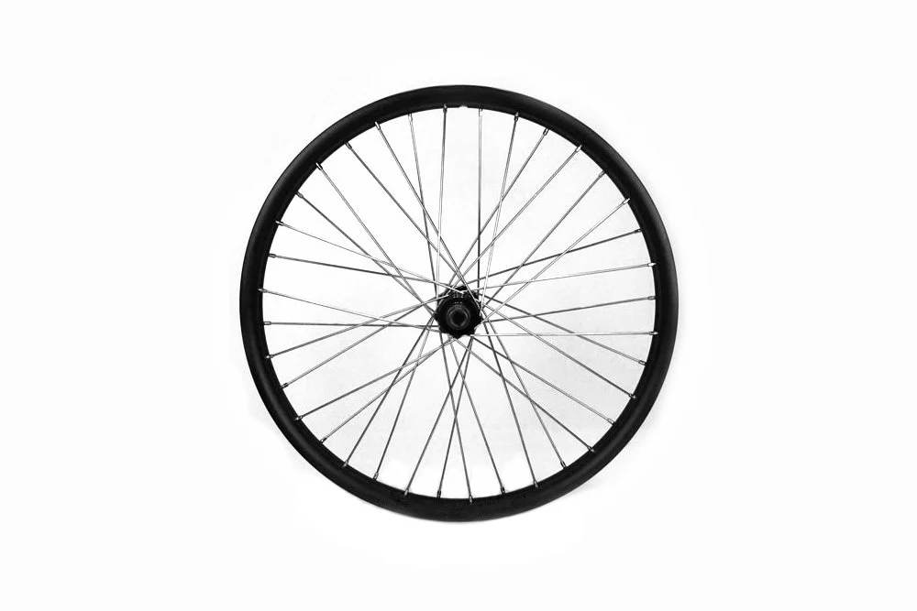
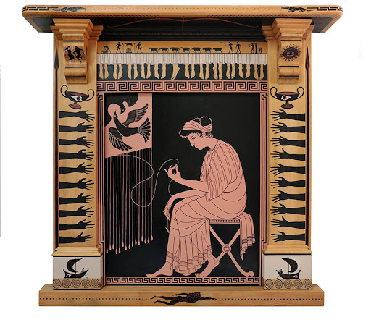
Establishing a Character Hub

Slide 9
Character Hub Purpose Statement
“Since its founding, Hope College has recognized character formation as an essential element of its mission because it promotes human flourishing and signifies God’s kingdom at hand. The Character Hub weaves past character initiatives more deeply into the fabric of campus and connects them to current and newly developed efforts in order to create a comprehensive and growing environment distinctly marked by gratitude and generosity.”

Slide 10
Research Grants
Three years of funding
  Year 1: 4 grants awarded
    Jared Ortiz
    Wayne Tan
    Roger Baumann
    Anita Esquerra-Zwiers, Brent Krueger, Stephanie Pangborn
  Year 2: 3 grants awarded
    Mihyun Han
    Lisa Walcott and Pablo Peschiera
    Liz Sharda and Rodrigo Serrao
  Year 3: 3 grants will be awarded

Slide 11
Character in Courses Teaching Fellowship
Course revision / redesign grants
  Year 1: 2025-26
    13 member cohort representing 3 divisions and 10 departments
  Year 2: 2026-27
    Up to 12 members
Developing online teaching library
  Cataloging all revised syllabi and multimedia modules made freely available to all, posted to our website

Slide 12
Workshops
Co-curricular programming and workshops
  Semesterly Greek Life Luncheons
    Targeted content: Awe and Gratitude
    Taking Hope Forward programming to an enlarged audience
    Targeted invitations and attendance
    A model for further growth
Notes:
Ellen will speak about the workshops.

Slide 13
Character Reflections
Our blog/journal; monthly entries; 500-1000 words
ICYMI: Topics
  September: Holding doors and saying thanks
  October: Virtues matter most when they’re hard to practice
  November: Giving and generosity
  December: Experiencing awe in community
  January: Personal change through a children’s bedtime book
  February: Patience as the least fun virtue
  March: Quilting and the fabric of Hope
  April and beyond: maybe you???

Slide 14
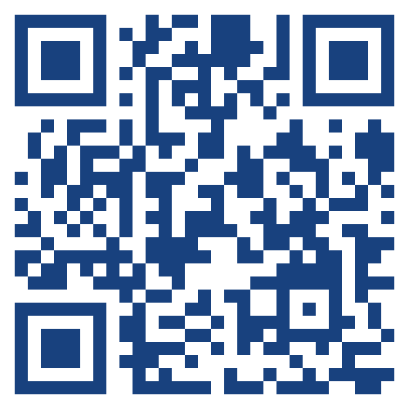
Website
hope.edu/character
A place to learn about the Character Hub, who’s involved, it’s activities, and funding opportunities
The website is still a work in progress, but we want to build it into a place where there are resources to help you with your work
Notes:
Chris

Slide 15
Assessment
Once a semester indirect assessment of student virtues, especially gratitude and generosity (proctored through the Frost Center; students are incentivized)
Virtue instrument (18 virtues): justice, self-control, forgiveness, compassion, temperance, courage, patience, humility, honesty, prudence, love, forbearance, gratitude, generosity, perseverance, open-mindedness, gentleness, fidelity
Spring 2025: 624 respondents; Fall 2025: 665 respondents

Slide 16
Assessment Results: Virtue
Generally, Spring 2025 and Fall 2025 respondents rated themselves similar across the virtues
We see a marginally significant difference between self-control scores in Spring 2025 and Fall 2025 such that self-control scores are marginally higher in the spring.
There is a marginally significant difference between generosity scores in Spring 2025 and Fall 2025 such that generosity scores are marginally higher in the fall.
All other comparisons between virtue scores were non-significant
For both S25 and F25, respondents tend to use the response options “5 – Somewhat True” , “6 – Mostly True”, and “7-Absolutely True” most often across virtues
In the future, it would be valuable to look at these trends within subgroups (age, year, exposure to Character Forward initiatives, First Generation status, etc.)
Prompt: “Please read through the following list of behaviors and indicate the degree to which you feel that you exemplify and demonstrate these characteristics. Please use the following scale.” Each characteristic has a colon and then a short description.

Slide 17
Assessment Results: Gratitude and Generosity
Gratitude (6 question instrument)
No significant differences across gratitude scores between Spring and Fall 2025.
Generosity (10 question instrument)
Fall 2025 respondents rated themselves significantly higher on the item “When it comes to my personal relationships with others, I am a very generous person” compared to Spring 2025 respondents
Fall 2025 respondents indicated significantly more agreement with the statement “My decisions are often based on concern for the welfare of others” compared to Spring 2025 respondents
There was a marginal difference in how students in the Spring 2025 and Fall 2025 responded to the statement “It makes me very happy to give to other people in ways that meet their needs” such that Fall respondents scored themselves marginally higher on this item.

Slide 18
Character Ambassadors
A group of eager students looking forward to promoting character on campus by:
Telling stories of the good using social media and designed presentations (FYS, Orientation, Anchor Days, etc.)
Hosting events and programming to promote good character on campus (stay tuned for more, coming in April!)

Slide 19
The Future
We’re ecstatic that Hope’s Strategic Plan is built around character in community, but questions about organizational location remain
In the meantime, we’re thrilled with our ongoing partnerships:
  Center for Teaching and Learning
  Nyenhuis program/Provost’s Office
  Hope Forward
  You???

Slide 20
Let’s discuss!

