Slide 1
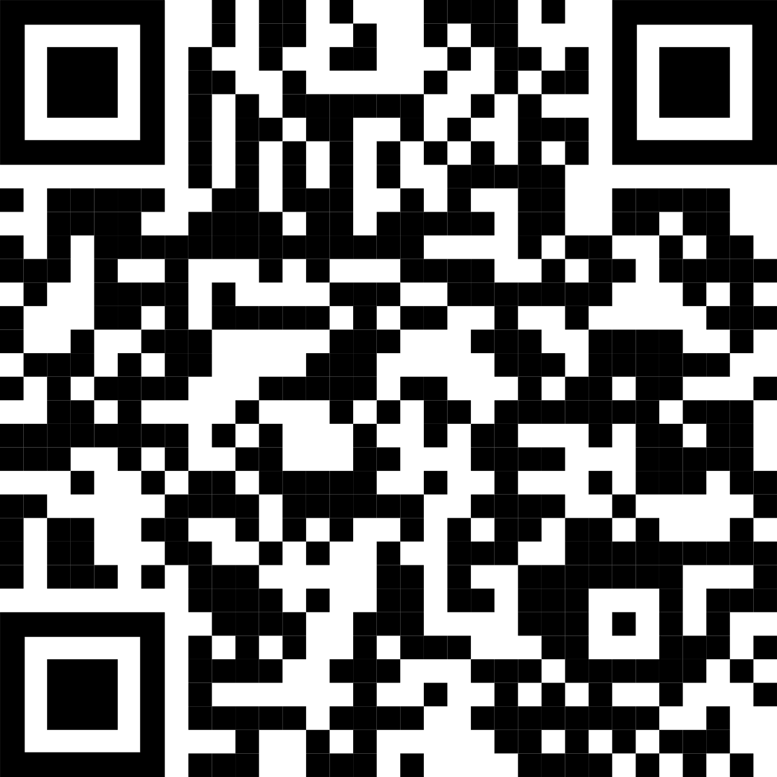

Non-Cognitive Predictors of Student Success:
A Predictive Validity Comparison Between Domestic and International Students
Non-Cognitive Predictors of Student Success:
A Predictive Validity Comparison Between Domestic and International Students
Title:
Subtitle
AMMO BAR
Delete this and replace it with your…
Extra Graphs
Extra Correlation tables
Extra Figures
Extra nuance that you’re worried about leaving out.
Citations
Keep it messy! This section is just for you.
PRESENTER: Your names here
INTRO:
Who cares? Explain why your study matters in the fastest, most brutal way possible (feel free to add graphics!).
METHODS
How did you find this?
Collected [what] from [population]
How you tested it.
Illustrate your methods if you can!
RESULTS
Graph/table with essential results only.
All the other correlations in the ammo bar.
Main finding goes here, translated into plain English. Emphasize the important words.
Generate QR codes here:
https://www.qrcode-monkey.com/
Leeroy Jenkins, author2,
author3, author4, author5, author6, author7, author42
Take a picture to
download the full paper

