Slide 1
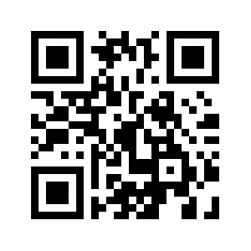
Title of Research Poster
Presenter(s) Name
INTRODUCTION
Mike Morrison created a template for a “Better Scientific Poster” (BSP) (https://osf.io/ef53g/)
The BSP format has been praised by many, yet disparaged by others.
The current project had 2 goals:
Create a template that I think could be useful.
Point out that we don’t need to either love or hate the new format—the middle is just fine.
RESULTS
Preregistered analysis: 78% increase in liking compared to traditional format and 24% increase compared to the BSP format
Why must we pick sides? Take the good parts of the new format, keep the useful aspects of the traditional format, add in your own ideas, and create something better.
Exploratory analysis: room for improvement in this template (Arial font, seriously?!?!).
METHOD
To create a new template, I identified strengths of the BSP template and the traditional format.
BSP strengths: clear take-away message, minimal text, QR code
Traditional format strengths: room for figures, reasonable text size on sides, large title to make finding posters in poster session easy, web link and email for people who don’t like QR codes
DISCUSSION
Sometimes it makes sense to pick a side; this is not one of those times.
Praise what you like, make suggestions for improvement, and then make something better.
Take Mike’s ideas, incorporate some of mine, be creative, and let’s make posters more useful.
Take a picture to download the full paper
Generate QR codes here: https://www.qrcode-monkey.com/

